Slide 1
[Organisation] · PHASE C
Data Security
Who can reach which data, derived from the process model, and where the controls are absent
4 Restricted entities · 2 external parties reach them · 3 controls absent
0.1 — Draft · June 2027

Slide 2
WHERE THIS SITS
A view, not a maintained artifact
A view, not a maintained artifact. The framework merged the data security diagram into the security architecture, and this is the data layer of it.
How access is derived
Role participates in Business Process, from R09. Business Process accesses Data Entity, from R17. Composing the two gives who can reach what.
What is authored here
Classification handling and the control assessment. The metamodel has no control object, which is raised as CR-029.
What it does not cover
Sixteen of twenty-seven roles participate in no modelled process. The matrix is the access that is modelled, not the access that exists.
Why that matters
A security view built from an incomplete process model understates exposure. It should be read as a floor.
The framework merged the data security diagram into the security architecture. This is the data layer of it.

Slide 3
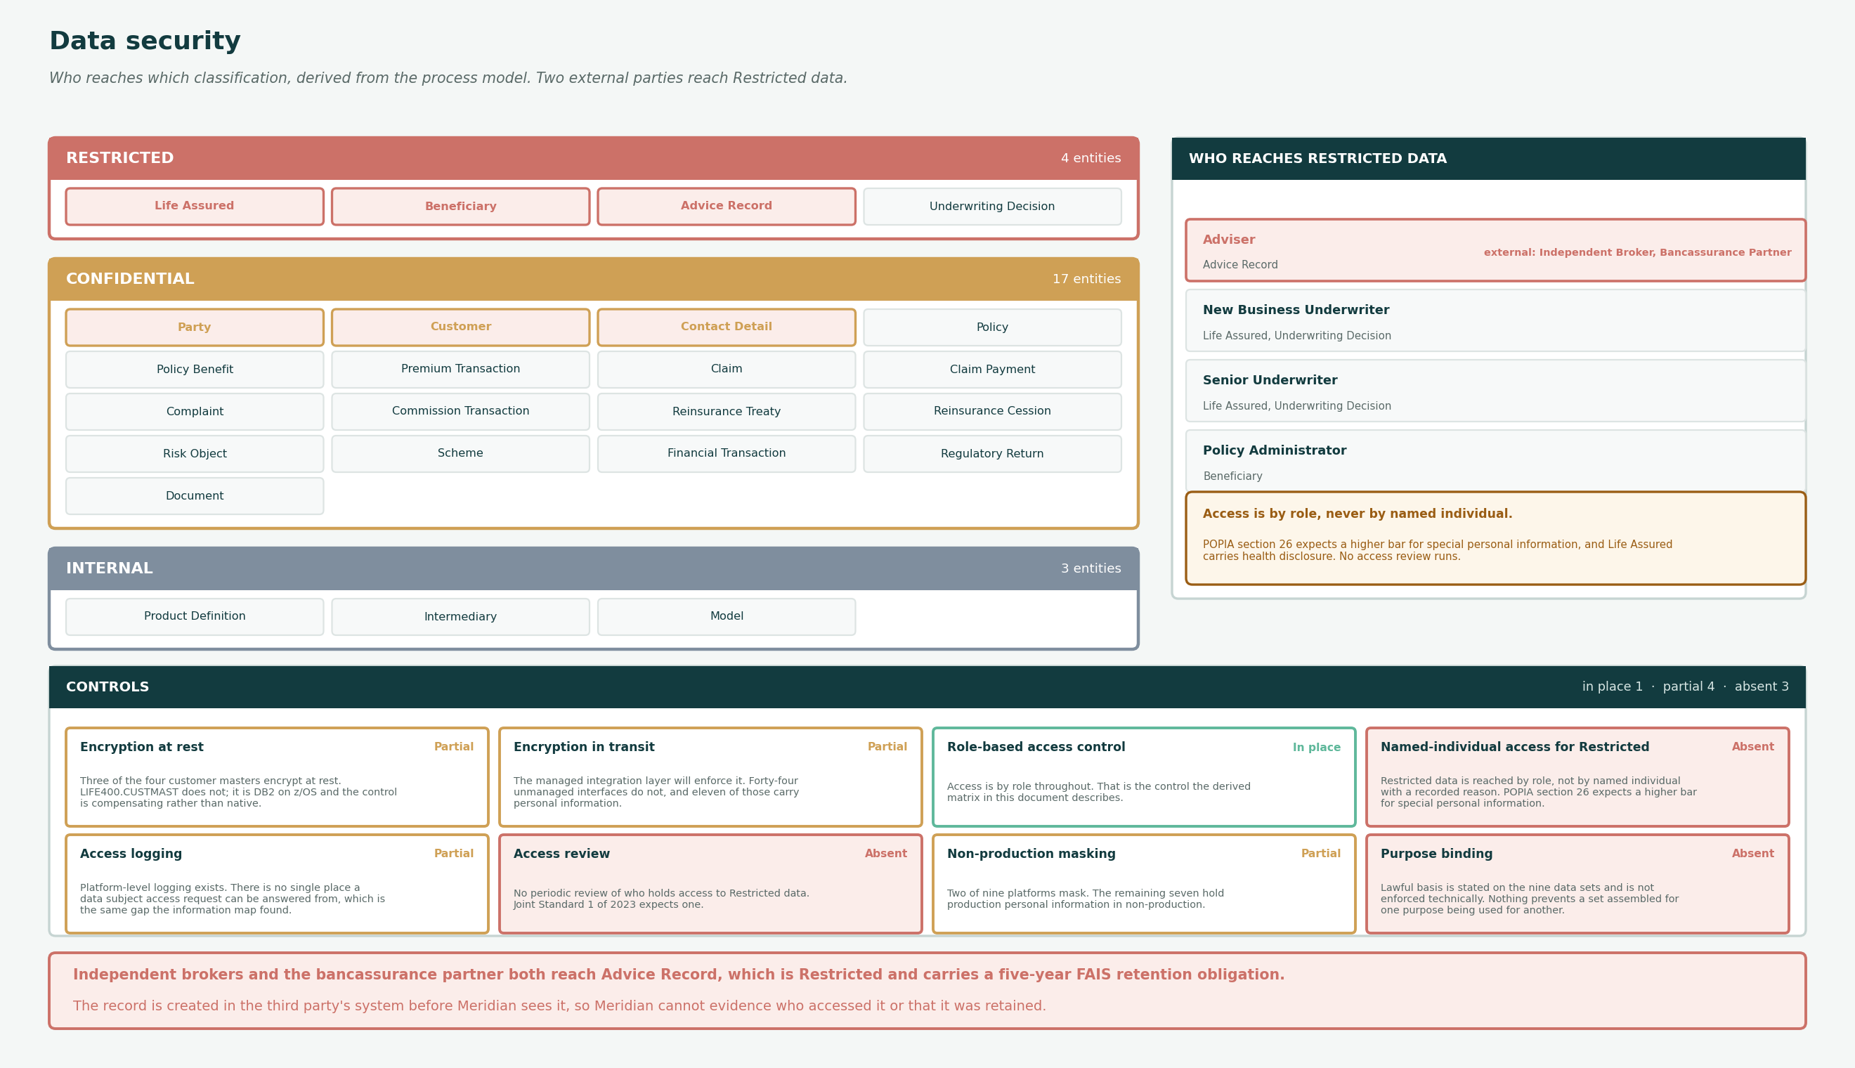
DATA SECURITY
Classification, access and controls
Shaded entities carry personal information. The full role-to-entity access matrix is in the workbook.

Slide 4
CLASSIFICATION AND HANDLING
Three classifications
The right-hand column is what is actually enforced, which is not what the handling rule requires.
Restricted
REQUIRED
ENFORCED TODAY
Encrypted at rest and in transit. Access on a named-individual basis with a recorded business reason. Access logged and reviewed monthly. Never leaves South Africa without a transfer basis.
Encryption is in place on three of four stores. Named-individual access is not implemented; access is by role. No access review runs.
4 entities
Special personal information under POPIA section 26, or information whose disclosure would cause serious harm to a data subject.
Confidential
REQUIRED
ENFORCED TODAY
Encrypted at rest. Role-based access with least privilege. Access logged. Masked in non-production.
Encryption in place. Least privilege is asserted and not tested. Non-production masking is applied on two platforms of nine.
17 entities
Personal information, or commercially sensitive information whose disclosure would harm [Organisation] or a counterparty.
Internal
REQUIRED
ENFORCED TODAY
Role-based access. No masking requirement.
In place.
3 entities
Information that is not personal and not commercially sensitive, but is not published.
Restricted requires named-individual access with a recorded reason. [Organisation] grants it by role, everywhere.

Slide 5
EXTERNAL ACCESS
Two external parties reach Restricted data
Three external actors perform an internal role. Two of them reach an entity classified Restricted.
Independent Broker
3,400 brokerages hold advice records that are Restricted and carry a five-year FAIS retention obligation. The record is created in the brokerage's own system before [Organisation] sees it.
performs ROL-01 Adviser
reaches DEN-12 Advice Record
Bancassurance Partner
The partner bank's advisers create advice records under the partner agreement. The lawful basis for [Organisation] holding them travels with the record and is not enforced technically.
performs ROL-01 Adviser
reaches DEN-12 Advice Record
Loss Adjuster
34 external firms exercise Mandated claims assessment authority. They reach Claim and Policy but no Restricted entity, which is the correct position and worth confirming rather than assuming.
performs ROL-05 Claims Assessor
reaches Confidential only
The loss adjuster reaches no Restricted entity, which is the correct position and worth confirming rather than assuming.

Slide 6
CONTROLS
Eight controls
One in place, four partial, three absent. The three absent are the ones a regulator would ask about first.
Encryption at rest
All Restricted and Confidential stores
Partial
Three of the four customer masters encrypt at rest. LIFE400.CUSTMAST does not; it is DB2 on z/OS and the control is compensating rather than native.
Encryption in transit
Every interface carrying personal information
Partial
The managed integration layer will enforce it. Forty-four unmanaged interfaces do not, and eleven of those carry personal information.
Role-based access control
Every entity
In place
Access is by role throughout. That is the control the derived matrix in this document describes.
Named-individual access for Restricted
Four Restricted entities
Absent
Restricted data is reached by role, not by named individual with a recorded reason. POPIA section 26 expects a higher bar for special personal information.
Access logging
Restricted and Confidential
Partial
Platform-level logging exists. There is no single place a data subject access request can be answered from, which is the same gap the information map found.
Access review
Restricted
Absent
No periodic review of who holds access to Restricted data. Joint Standard 1 of 2023 expects one.
Non-production masking
Personal information in test environments
Partial
Two of nine platforms mask. The remaining seven hold production personal information in non-production.
Purpose binding
Every data set
Absent
Lawful basis is stated on the nine data sets and is not enforced technically. Nothing prevents a set assembled for one purpose being used for another.
Purpose binding is the one worth arguing about. Lawful basis is stated on all nine data sets and enforced by nothing.

Slide 7
FINDINGS
What the data security view shows
Two external parties reach Restricted data
Independent brokers and the bancassurance partner both perform the Adviser role, which reaches Advice Record. That entity is Restricted and carries a FAIS retention obligation.
This is not necessarily wrong: an adviser must record advice. It is unmanaged, because the record is created in the third party's system before [Organisation] sees it, and [Organisation] cannot evidence who accessed it or that it was retained for five years.
Restricted data is protected by role, not by individual
All four Restricted entities are reached through role-based access. Named-individual access with a recorded business reason is not implemented anywhere.
POPIA section 26 expects a higher bar for special personal information, and Life Assured carries health disclosure. The control is absent rather than weak, which is a simpler thing to fix and a harder thing to defend.
Sixteen of twenty-seven roles have no modelled access at all
Only eleven roles participate in a business process, so the derived access matrix covers eleven.
The other sixteen do work and reach data. The matrix in this document is therefore a floor, not a picture, and it should be read as the access that is modelled rather than the access that exists.
No access review runs against Restricted data
Joint Standard 1 of 2023 expects periodic review of privileged and sensitive access. None runs.
The remediation is procedural rather than technical, which usually means it is cheap and unowned. It has no work package.
Purpose is stated on data sets and enforced nowhere
All nine data sets name a lawful basis. Nothing technical prevents a set assembled for one purpose being used for another.
Stating the basis was the right thing to do at design. Binding it is the control, and the gap between the two is where a POPIA finding would land.
Access review is procedural rather than technical, which usually means it is cheap and unowned. It has no work package.

